Slide 1



UNIVERSITY OF HYDERABAD
SCHOOL OF MANAGEMENT STUDIES
BIG DATA ANALYTICS
Capstone Project Presentation
Predicting the Next Blockbuster
Data-Driven Forecasting and Audience Analytics
Name: Yashika
Roll Number:24MBMB23
MBA Business Analytics
sem 3rd

Slide 2
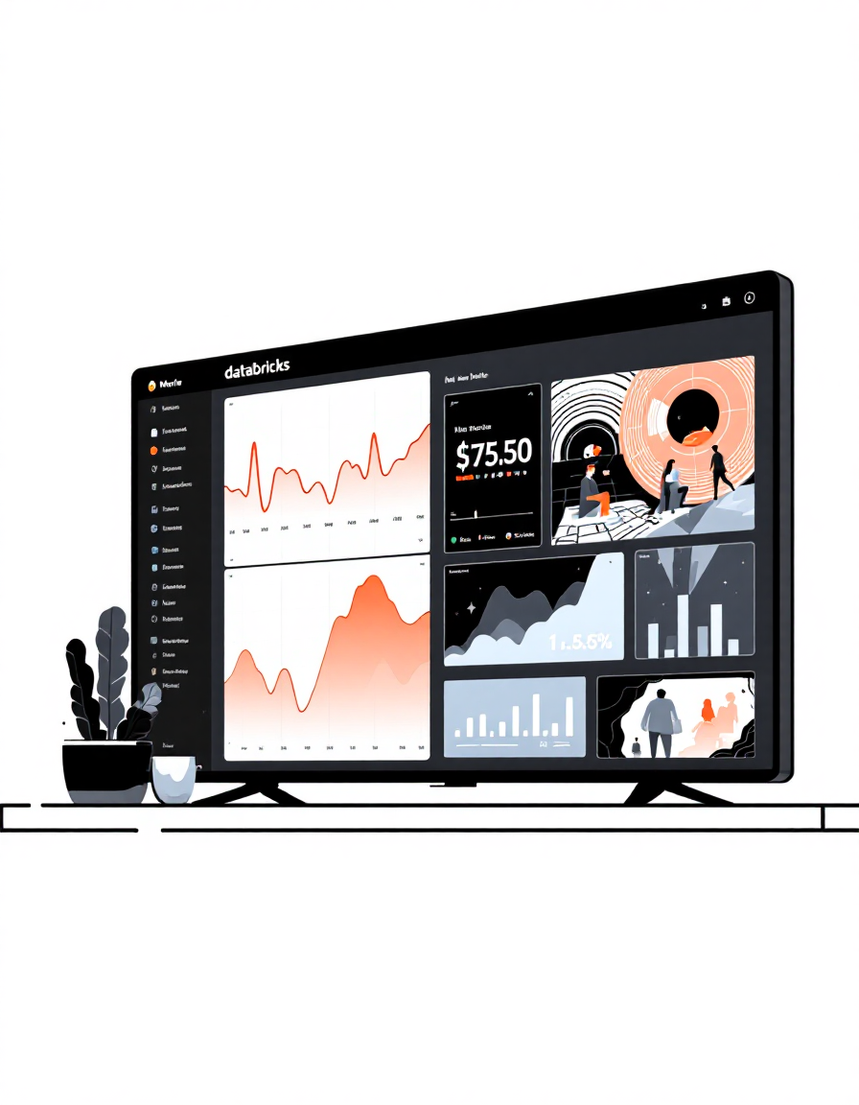
Project Overview
Project Objective
Apply Big Data Analytics and Machine Learning to predict movie success, analyze audience sentiment, forecast trends, and recommend content for smarter decision-making.
Industry Context
The M&E industry generates massive data from streaming, reviews, and box office. Netflix, Amazon Prime, and Disney+ rely on analytics for content strategy.
Tools & Frameworks
Platform: Databricks, Apache Spark
ML: Spark MLlib
Languages: PySpark, SQL
Visualization: Matplotlib, Dashboards

Slide 3
Datasets & Methodology
Datasets Used
Big Data Workflow
01
Data Ingestion
TMDB 5000 Movies
Budget, Revenue, Popularity, Vote Average, Vote Count. Used for Use Cases 1, 3, 4, and 5.
02
Cleaning & Feature Engineering
03
Model Building {MLib)
IMDB Reviews
Review Text, Sentiment (Positive/Negative). Used for Use Case 2.
04
Evaluation & Visualizations
05
Insights & Recommendations

Slide 4
Use Case Summary
Use Case | Goal | Technique Used | Key Result
1. Box Office Success Prediction | Predict if movie will be profitable | Multi class classification evaluator | Accuracy 77%, AUC 0.85 — Popularity & vote_count are key
2. Audience Sentiment Analysis | Analyze review sentiment | TF-IDF + Logistic Regression | Accuracy 88%, AUC 0.95, strong correlation between sentiment & success
3. Trend Forecasting | Predict future movie popularity | Polynomial Regression | R² 0.67, rising trend in popularity (2010–2030)
4. Viewer Engagement Prediction | Predict engagement level | Decision Tree Classifier | Accuracy 95.2%, vote_count most important (0.987)
5. Content Recommendation Optimization | Group similar movies for recommendation | K-Means Clustering | 4 clusters formed — Blockbusters, Niche, Average, Acclaimed

Slide 5
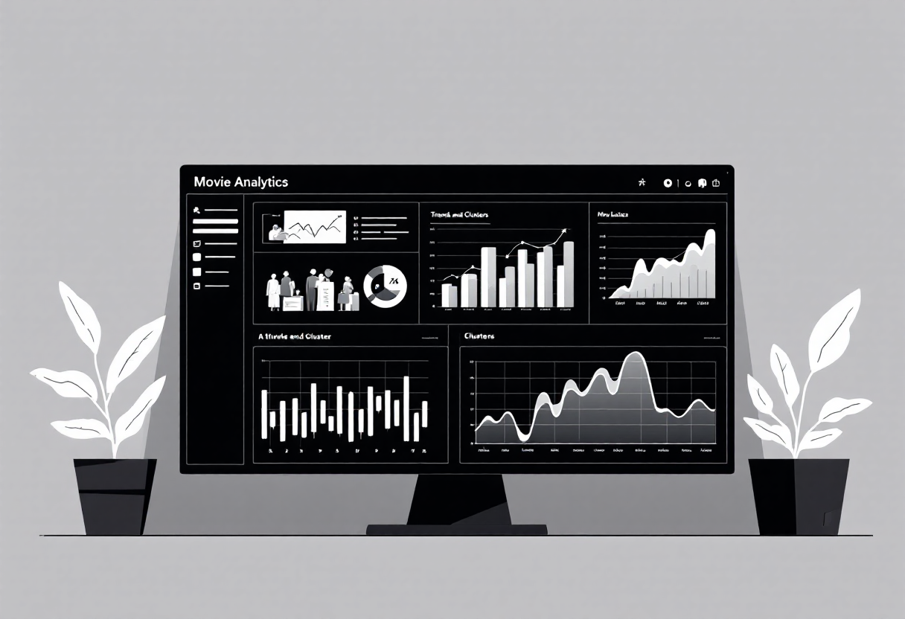
Results & Insights
0.74
0.88
0.95
4
Box Office Prediction
Accuracy with AUC 0.85
Content Clusters
Groups for Recommendations
Sentiment Analysis
Accuracy with AUC 0.95
Engagement Prediction
Accuracy using Decision Tree
Key Findings
Popularity & audience votes strongly influence both success and engagement
Positive sentiments from IMDB reviews align with higher ratings
Trend forecast shows continued audience growth due to streaming adoption
K-Means clustering enables personalized movie recommendations

Slide 6
Conclusion & Future Scope
Conclusion
Demonstrated 5 Big Data applications in Media & Entertainment
Used Spark MLlib for classification, clustering, and trend analysis
Achieved strong predictive accuracy and valuable audience insights
Built foundation for AI-driven content strategy in streaming platforms
Business Impact
Pre-Release Success
Predict movie success before launch
Real-Time Analysis
Analyze audience mood instantly
Trend Forecasting
Forecast industry growth patterns
Content Strategy
Recommend similar content for retention
Future Enhancmenets
Real-Time Data
Integrate Netflix/Twitter APIs for live streaming data
Deep Learning
Add LSTM models for advanced forecasting
Dashboard Interface
Create real-time visualization platform
Multi-Language
Expand to multi-language sentiment models

